Slide 1
Macro Processors
Basic Functions
Machine-Independent Features
Design Options
Implementation Examples

Slide 2
Macro Instructions
A macro instruction (macro)
  It is simply a notational convenience for the programmer to write a shorthand version of a program.
  It represents a commonly used group of statements in the source program.
  It is replaced by the macro processor with the corresponding group of source language statements. This operation is called “expanding the macro”
For example:
  Suppose it is necessary to save the contents of all registers before calling a subroutine.
  This requires a sequence of instructions.
  We can define and use a macro, SAVEREGS, to represent this sequence of instructions.

Slide 3
Macro Processors
A macro processor
  Its functions essentially involve the substitution of one group of characters or lines for another.
  Normally, it performs no analysis of the text it handles.
  It doesn’t concern the meaning of the involved statements during macro expansion.
Therefore, the design of a macro processor generally is machine independent.
Macro processors are used in
  assembly language
  high-level programming languages, e.g., C or C++
  OS command languages
  general purpose

Slide 4
Basic Functions
Macro Definition
Macro Invocation
Macro Expansion
One-Pass Algorithm
Data Structure

Slide 5
Macro Definition
Two new assembler directives are used in macro definition:
  MACRO: identify the beginning of a macro definition
  MEND: identify the end of a macro definition
Prototype (pattern) for the macro:
  Each parameter begins with ‘&’
label op operands
  name MACRO parameters
  :
  body
  :
  MEND
Body: the statements that will be generated as the expansion of the macro.

Slide 6
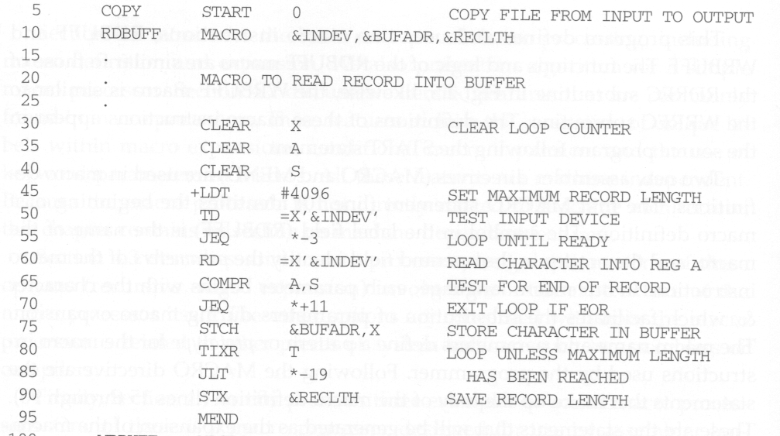
Example of Macro Definition
Macro definition
Macro body contains no label

Slide 7
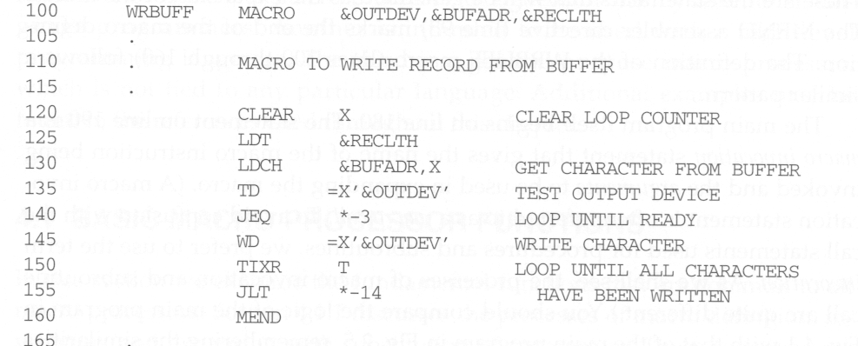
Example of Macro Definition
Macro definition
Macro body contains no label

Slide 8
Macro Invocation
A macro invocation statement (a macro call) gives the name of the macro instruction being invoked and the arguments in expanding the macro.
The processes of macro invocation and subroutine call are quite different.
  Statements of the macro body are expanded each time the macro is invoked.
  Statements of the subroutine appear only one, regardless of how many times the subroutine is called.

Slide 9
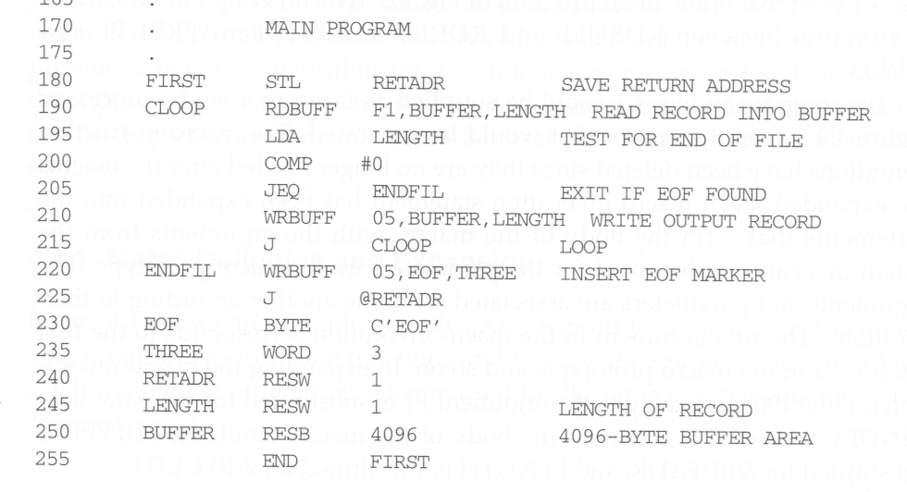
Example of Macro Invocation
Macro invocations

Slide 10
Macro Expansion
Each macro invocation statement will be expanded into the statements that form the body of the macro.
Arguments from the macro invocation are substituted for the parameters in the macro prototype.
  The arguments and parameters are associated with one another according to their positions.
    The first argument in the macro invocation corresponds to the first parameter in the macro prototype, etc.

Slide 11
Macro Expansion
Comment lines within the macro body have been deleted, but comments on individual statements have been retained.
Macro invocation statement itself has been included as a comment line.
The label on the macro invocation statement CLOOP has been retained as a label on the first statement generated in the macro expansion.
This allows the programmer to use a macro instruction in exactly the same way as an assembler language mnemonic.

Slide 12
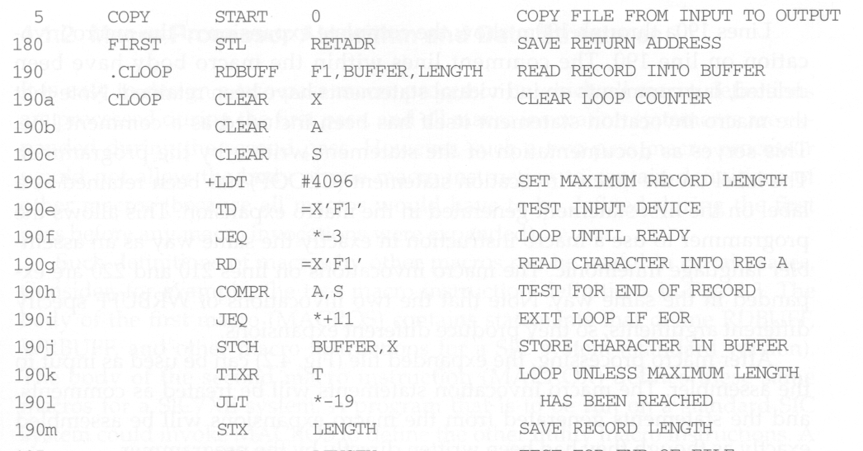
Example of Macro Expansion

Slide 13
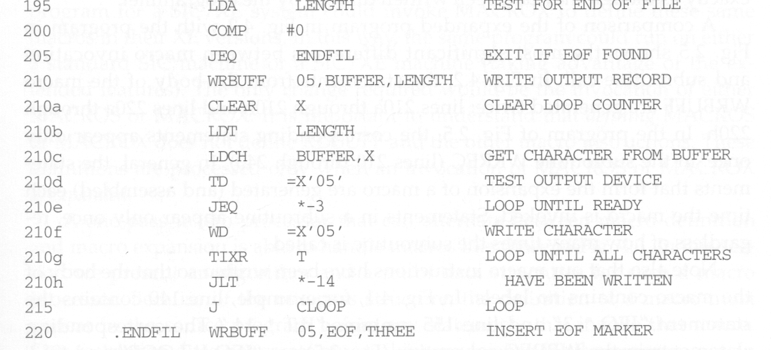
Example of Macro Expansion
.

Slide 14
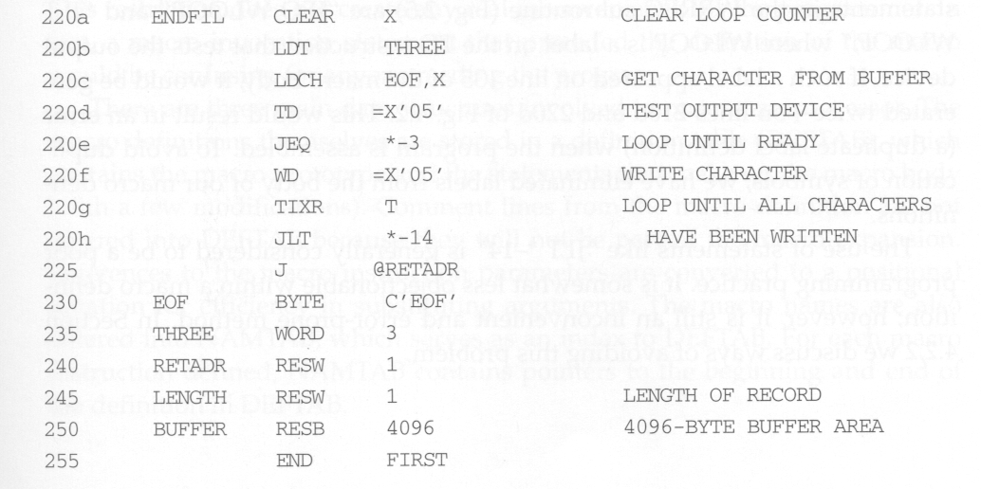
Example of Macro Expansion

Slide 15
No Label in the Body of Macro
Problem of the label in the body of macro:
  There will be duplicate labels, which will be treated as errors by the assembler, if the same macro is expanded multiple times at different places in the program.
Solutions:
  Simply not to use labels in the body of macro. Explicitly use PC-relative addressing instead.
    For example, in RDBUFF and WRBUFF macros,
    JEQ * +11
    JLT *-14
    It is inconvenient and error-prone.
  Other better solution?

Slide 16
Two-Pass Macro Processor
Two-pass macro processor
  Pass 1:
    Process macro definition
  Pass 2:
    Expand all macro invocation statements
Problem
  This kind of macro processor cannot allow recursive macro definition, that is, the body of a macro contains definitions of other macros (because all macros would have to be defined during the first pass before any macro invocations were expanded).

Slide 17
Example of Recursive Macro Definition
MACROS (for SIC)
  contains the definitions of RDBUFF and WRBUFF written in SIC instructions.
MACROX (for SIC/XE)
  contains the definitions of RDBUFF and WRBUFF written in SIC/XE instructions.
A program that is to be run on SIC system could invoke MACROS whereas a program to be run on SIC/XE can invoke MACROX.
Defining MACROS or MACROX does not define RDBUFF and WRBUFF. These definitions are processed only when an invocation of MACROS or MACROX is expanded.
The same macro name

Slide 18
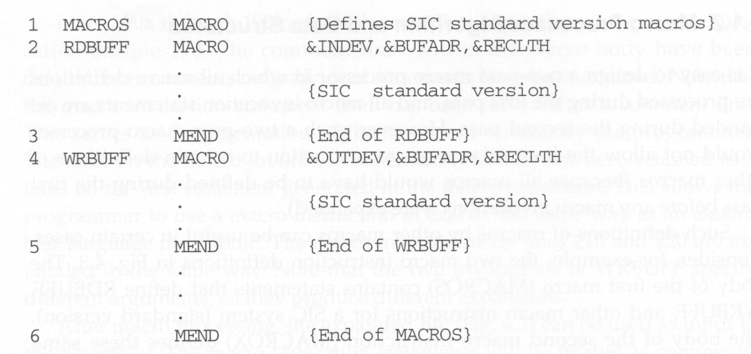
Example of Recursive Macro Definition

Slide 19
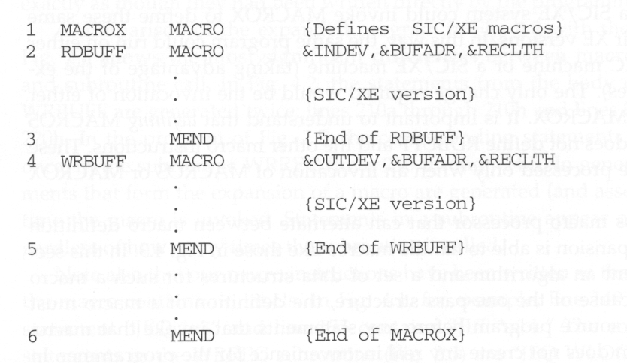
Example of Recursive Macro Definition

Slide 20
One-Pass Macro Processor
A one-pass macro processor that alternate between macro definition and macro expansion in a recursive way is able to handle recursive macro definition.
Because of the one-pass structure, the definition of a macro must appear in the source program before any statements that invoke that macro.

Slide 21
Data Structures
DEFTAB (definition table)
  Stores the macro definition including
    macro prototype
    macro body
  Comment lines are omitted.
  References to the macro instruction parameters are converted to a positional notation for efficiency in substituting arguments.
NAMTAB
  Stores macro names
  Serves an index to DEFTAB
    pointers to the beginning and the end of the macro definition
ARGTAB
  Stores the arguments of macro invocation according to their positions in the argument list
  As the macro is expanded, arguments from ARGTAB are substituted for the corresponding parameters in the macro body.

Slide 22
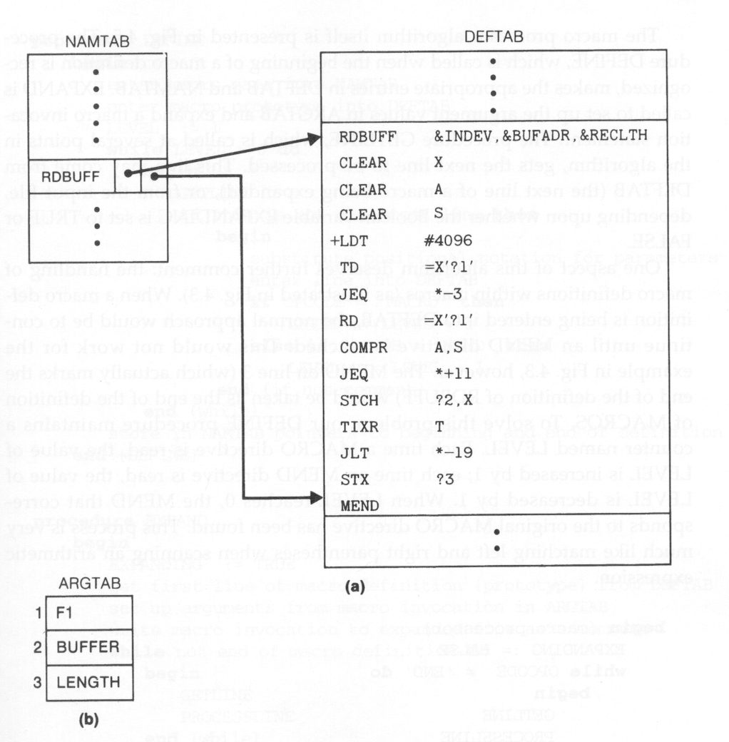
Data Structures

Slide 23
Algorithm
MAIN procedure
  iterations of
    GETLINE
    PROCESSLINE
PROCESSLINE procedure
  DEFINE
  EXPAND
  output source line
DEFINE procedure
  make appropriate entries in DEFTAB and NAMTAB
EXPAND procedure
  set up the argument values in ARGTAB
  expand a macro invocation statement (like in MAIN procedure)
    iterations of
      GETLINE
      PROCESSLINE
GETLINE procedure
  get the next line to be processed from
    input file
    DEFTAB

Slide 24
Handling Recursive Macro Definition
In DEFINE procedure
  When a macro definition is being entered into DEFTAB, the normal approach is to continue until an MEND directive is reached.
  This would not work for recursive macro definition because the first MEND encountered in the inner macro will terminate the whole macro definition process.
  To solve this problem, a counter LEVEL is used to keep track of the level of macro definitions.
    Increase LEVEL by 1 each time a MACRO directive is read.
    Decrease LEVEL by 1 each time a MEND directive is read.
    A MEND can terminate the whole macro definition process only when LEVEL reaches 0.
    This process is very much like matching left and right parentheses when scanning an arithmetic expression.

Slide 25
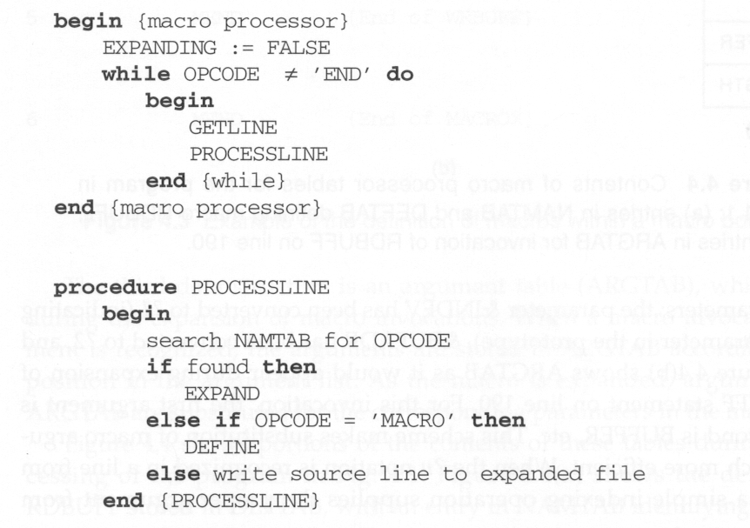
Algorithm

Slide 26
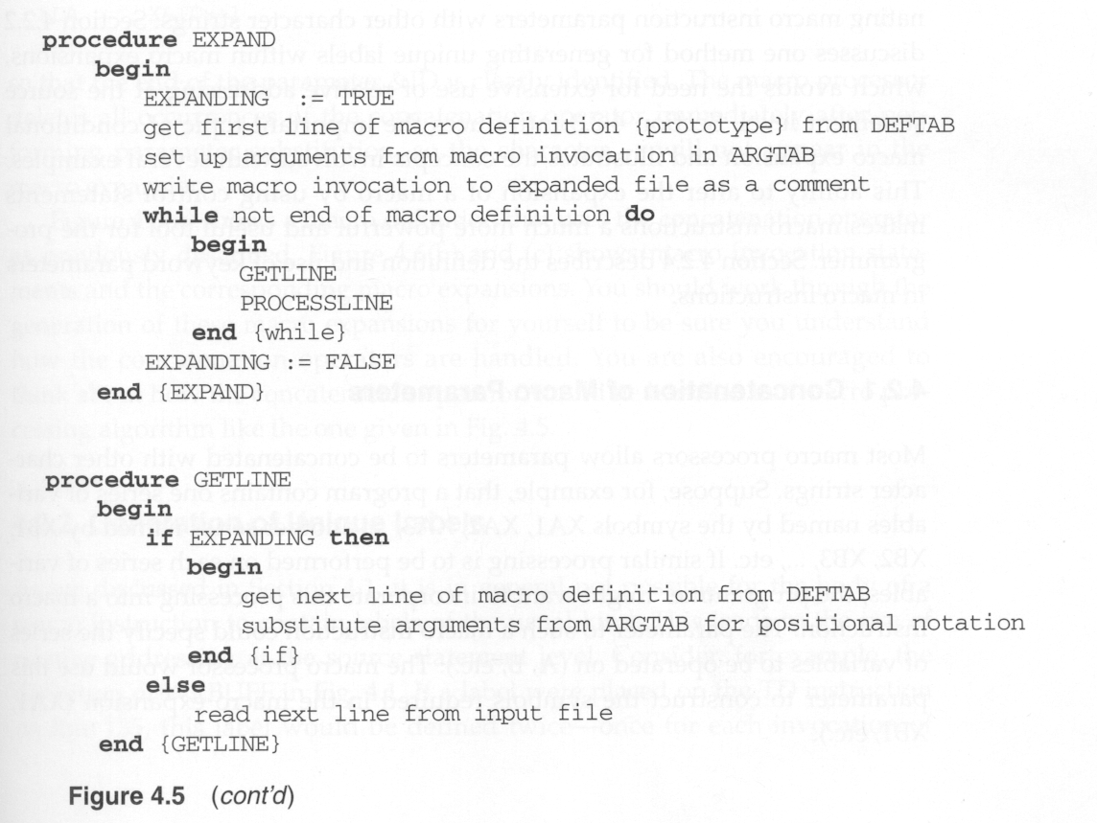
Algorithm

